Slide 1
4 Online Workshops on the INSPIRE-Soil GeoPackage
The INSPIRE-SOIL GeoPackage has been produced by
Andrea Lachi, Giovanni L’ Abate, Maria Fantappiè [CREA, Council for Agricultural Research and Economics of Italy] with the support of Stefania Morrone [Epsilon Italia srl].

Slide 2
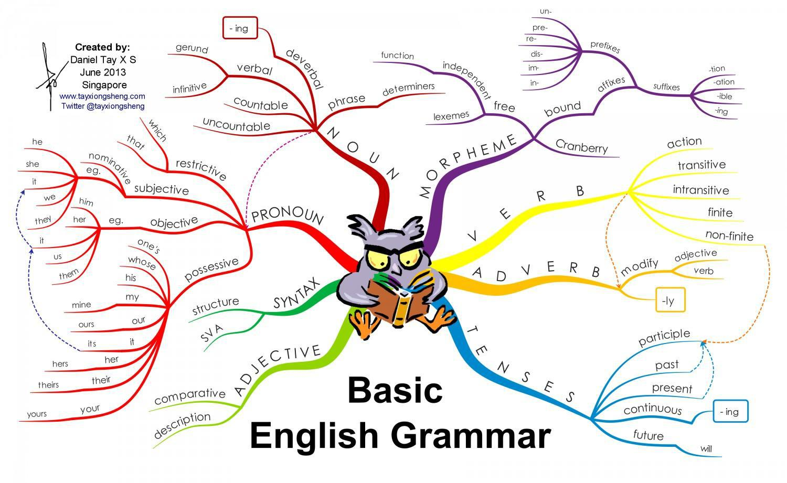
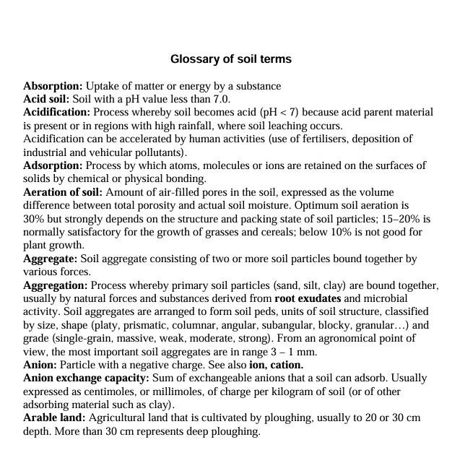
IT IS IMPORTANT TO FOLLOW ALL THE 4 WORKSHOPS
The Vocabularies = > 4° workshop to understand each other we also need Vocabularies, Codelists!
e.g.
https://esdac.jrc.ec.europa.eu/ESDB_Archive/Glossary/Glossary.pdf
Practical examples of usage with QGIS and Hale studio = >
2° and 3° workshops to import and export data
Grammatic Structural Components and Rules = >
1° workshop on standard conceptual models for soil
INSPIRE soil UML model + Observation&Measurement model + SensorThings model.…
and the physical implementation in the SOIL-Geopackage format compliant with INSPIRE regulation.

Slide 3
1st Workshop A Good Practice to facilitate the encoding of soil data in accordance with the INSPIRE Soil Data Specifications
Basic introduction to: INSPIRE Soil and O&M – INSPIRE Good Practice mechanism – EJPSOIL Good Practice for INSPIRE Soil in GeoPackage encoding

Slide 4
Outline
11:05 -11:25
11:40 – 12:00
12:15 – 12:35
Basic introduction to INSPIRE & INSPIRE Soil model structures (the Features of Interest)
Connecting soil properties and measurements to the Features of Interest
The INSPIRE SOIL implementation in Geopackage format
What is INSPIRE
Simplification of INSPIRE implementation
INSPIRE Good Practice mechanism
INSPIRE UML Soil Data Model
11:25 – 11:30 Coffee break
11:30 – 11:40 Q&A
Observation&Measurements (O&M) standard
Provision of sensor-based observations
OGC SensorThings API (STA) standard
12:00 – 12:05 Coffee break
12:05 – 12:15 Q&A
Good Practice on the GeoPackage encoding of INSPIRE datasets
EJP SOIL Good Practice to facilitate the encoding of INSPIRE soil data
12:35 – 12:40 Coffee break
12:40 – 13:00 Q&A & Mentimeter

Slide 5
Basic introduction to INSPIRE and to the INSPIRE Soil model structures (the Features of Interest)

Slide 6
Basic introduction to INSPIRE

Slide 7

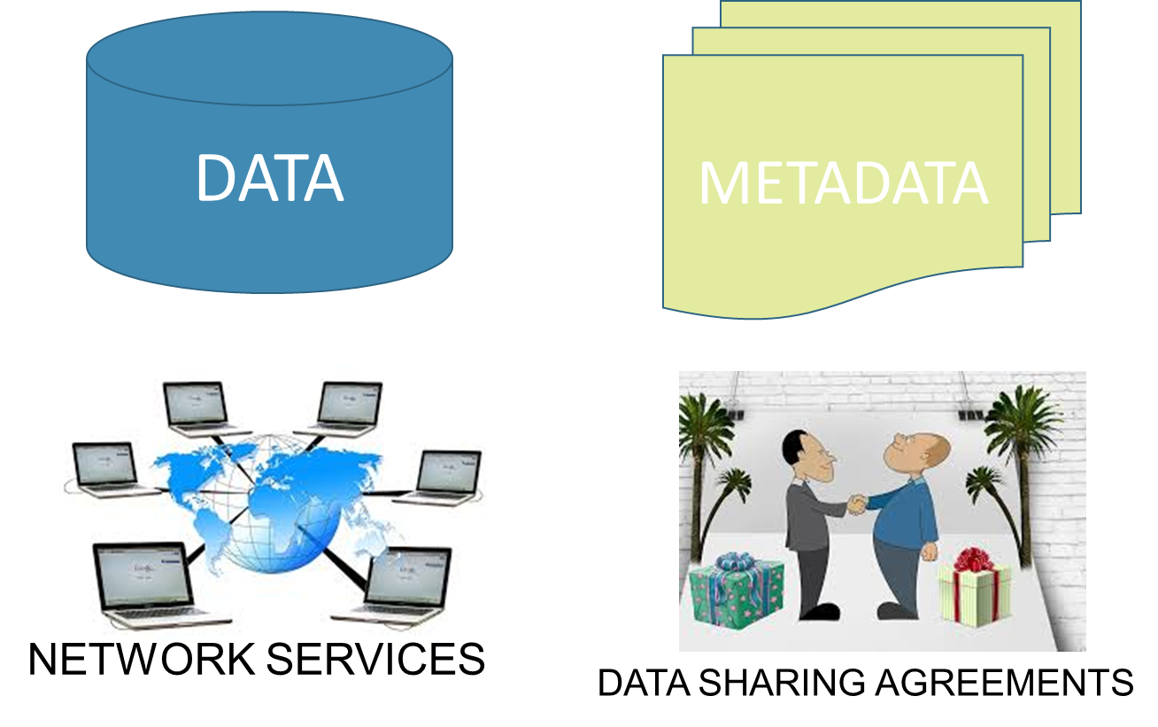
What is INSPIRE (Directive 2007/2/EC )?
It is a legal, technical and organisational framework to create an infrastructure for spatial information in Europe facilitating the sharing and re-use of data across the EU in support of environmental policy and decision-making.
Spatial Data Infrastructure
Towards Findable Accessible Interoperable Reusable spatial data
Harmonise data through common data models, shared vocabularies and standard encoding to make it interoperable
Publish data through standard network services (view and download) to make it accessible
Document data through standard metadata (published via discovery services) to make it findable and (re)usable

Slide 8
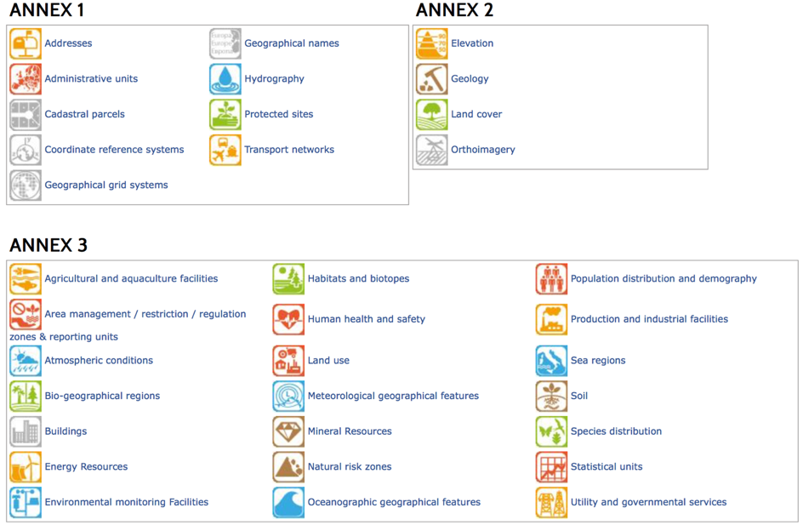
INSPIRE Data Themes
The INSPIRE Directive
Identifies 34 spatial data themes as necessary for the successful establishment of an environmental information system
Groups them into three annexes (Annex I, II and III) for a stepwise, prioritised implementation.
Soil Theme is in ANNEX III

Slide 9
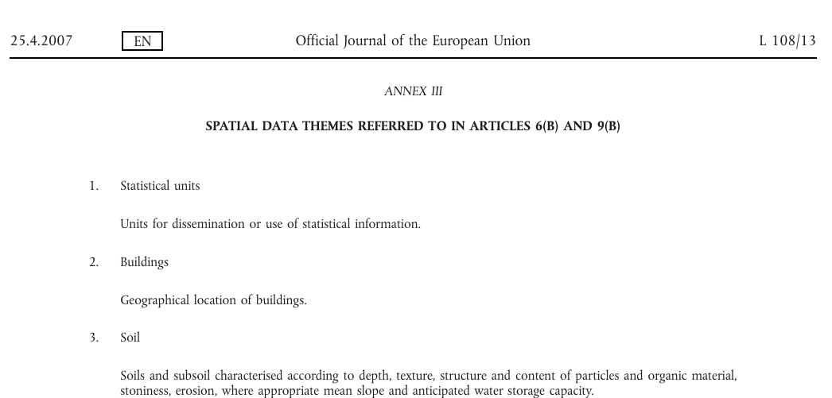
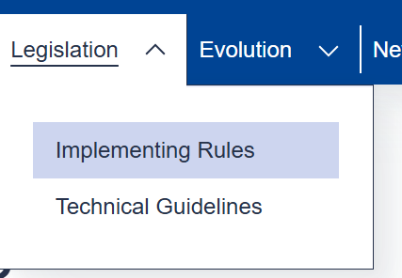

The Directive
The technical implementation
Legally binding
https://knowledge-base.inspire.ec.europa.eu/legislation/implementing-rules_en
Statistical units
Buildings
Soil
Soils and subsoil characterised according to depth, texture, structure and content of particles and organic material, stoniness, erosion, where appropriate mean slope and anticipated water storage capacity.
Land use
Human health and safety
Utility and governmental services
Environmental monitoring facilities
Production and industrial facilities
Agricultural and aquaculture facilities
https://github.com/INSPIRE-MIF/technical-guidelines
Describe how the MS might implement the IRs
https://inspire-mif.github.io/technical-guidelines/data/so/dataspecification_so.pdf

Slide 10
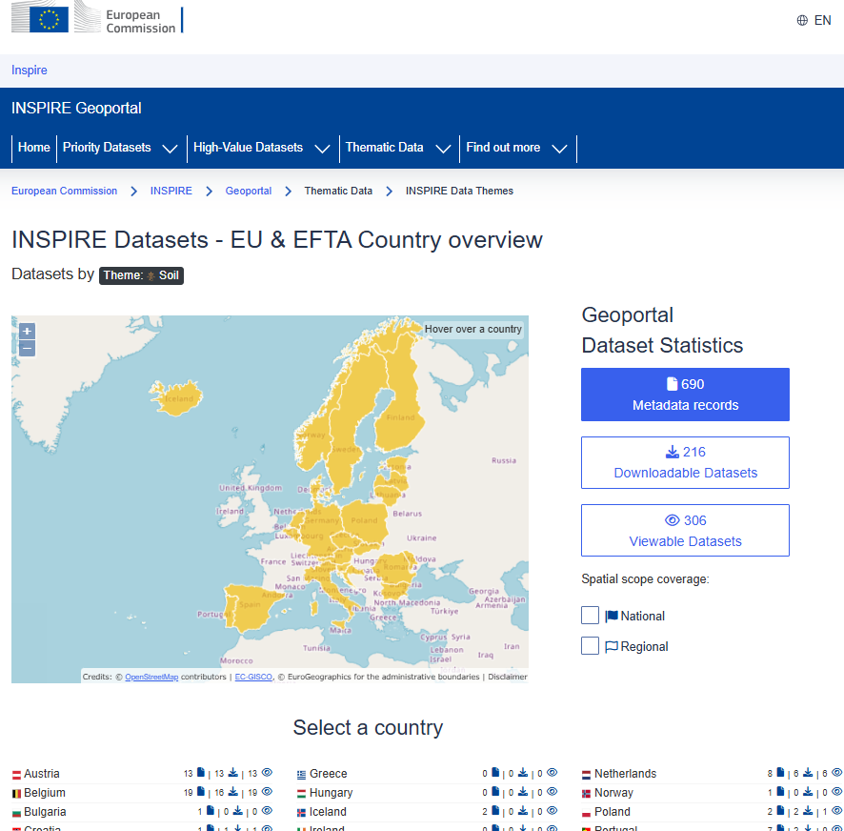
A central access point to the INSPIRE data
Soil data available in the INSPIRE Geoportal
The INSPIRE Geoportal allows:
monitoring the availability of datasets in scope;
discovering suitable datasets based on their descriptions (metadata);
accessing the selected datasets through their view or download services.
https://inspire-geoportal.ec.europa.eu/

Slide 11
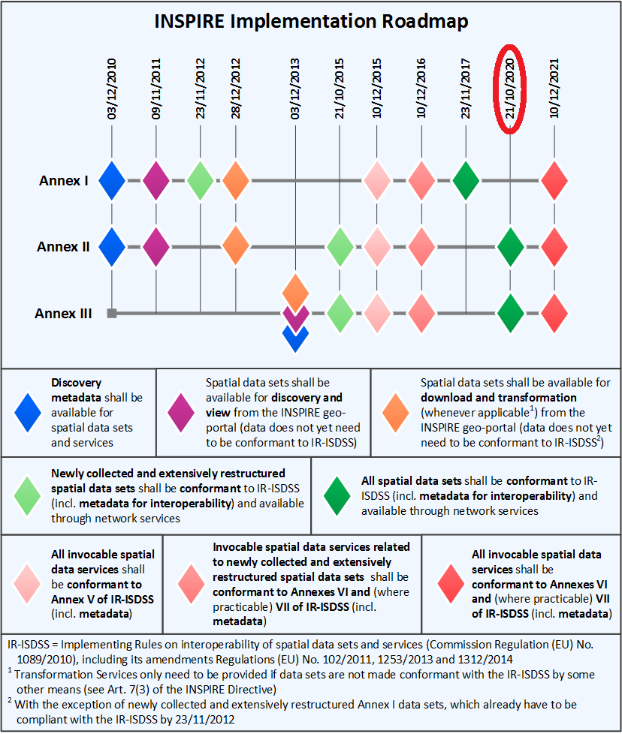
The INSPIRE Roadmap

Slide 12
Simplification of INSPIRE implementation

Slide 13
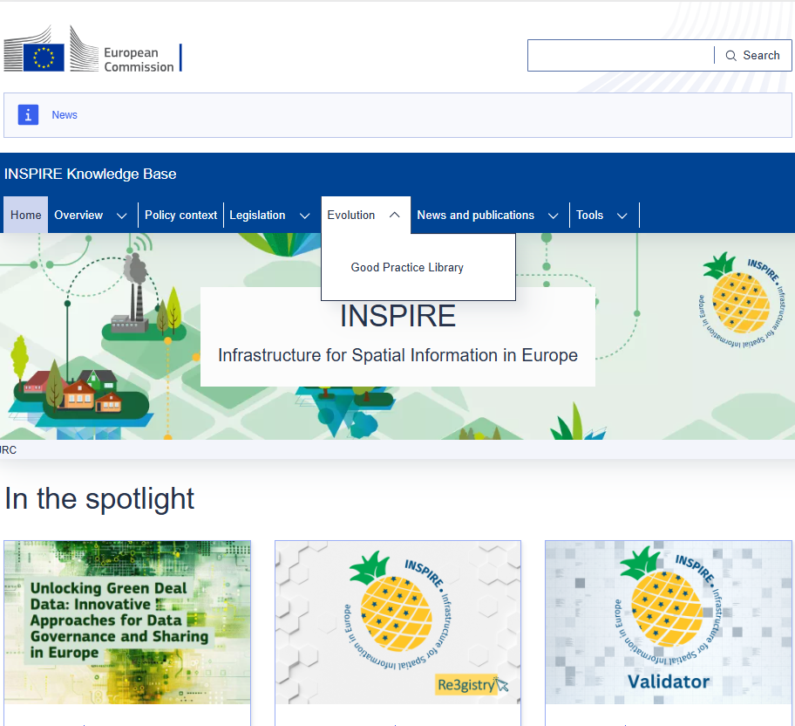
Reasons for simplifying and modernising INSPIRE
INSPIRE perceived as too complex, resulting in fragmented implementation and low community involvement.
Existing SW tools not always suitable for the technical implementation of INSPIRE.
Excessively long update procedures for TGs, UML models and XML schemas.
Technological evolution since the entry into force of the Directive.

Slide 14
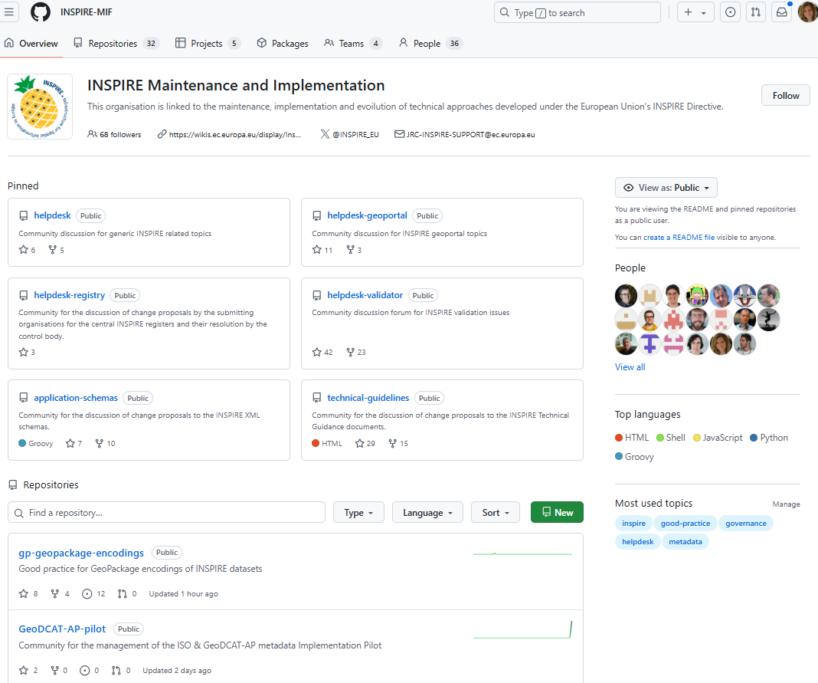
New Governance - Simplification of implementation
Implementation experience showed the need for
updated/new TGs e.g., to provide for new technologies
mechanisms and processes to enable updating, facilitate implementation and maximize reuse of INSPIRE.
INSPIRE Work Programme 2021-24, resulted, among others, in a new governance process for INSPIRE artefacts and the Good Practice mechanism.
To enhance transparency and community involvement, the GitHub platform is used to support the maintenance, implementation and evolution of the technical approaches of INSPIRE ('INSPIRE-MIF' organisation and related repositories)

Slide 15
INSPIRE Good Practice mechanism

Slide 16
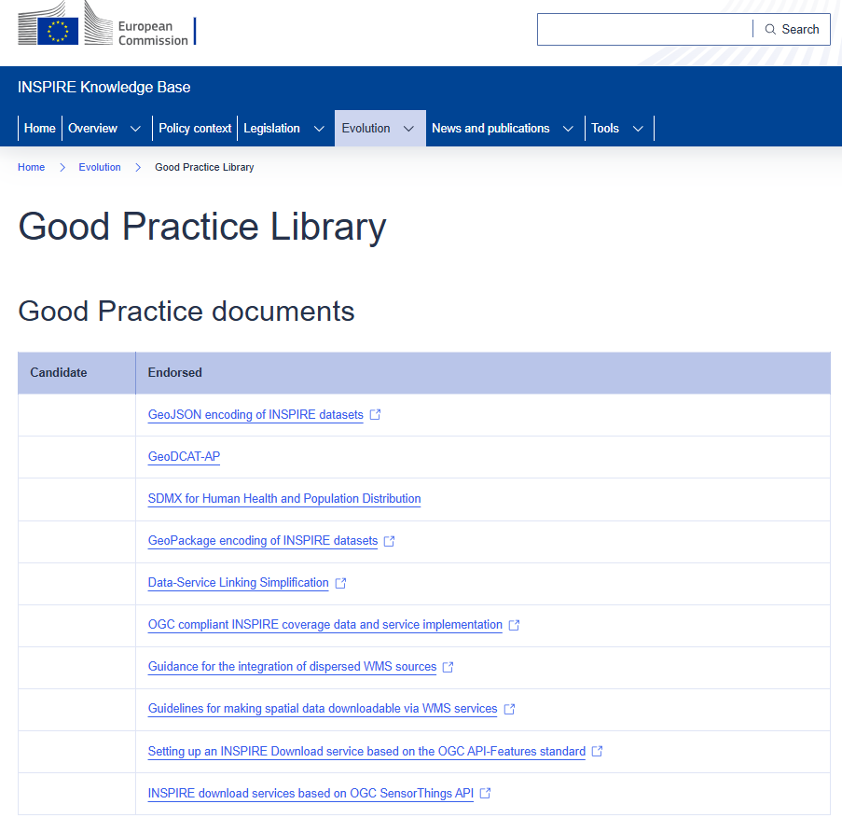
The INSPIRE Good Practice mechanism
Good Practices complement the initial set of INSPIRE Implementing Rules (IRs) and related Technical Guidelines (TGs).
Following a specific process culminating in final approval by the MIG (INSPIRE Maintenance and Implementation Group), a Good Practice specification becomes part of the INSPIRE technical documents.

Slide 17
INSPIRE Good Practice examples
Good practices examples include:
The extension/development of key elements of INSPIRE to support specific community needs, e.g., extended or simplified data models.
Use of tools / techniques /standards that can facilitate the implementation and reuse of INSPIRE, e.g., the use of different encodings for data, such as the GeoPackage and GeoJSON.
Technologies to improve the usability/usefulness of the spatial data infrastructures, e.g., sharing spatial data on the web using download services based on OGC API Features.

Slide 18
INSPIRE Soil Data Model Standard
Spatial objects

Slide 19
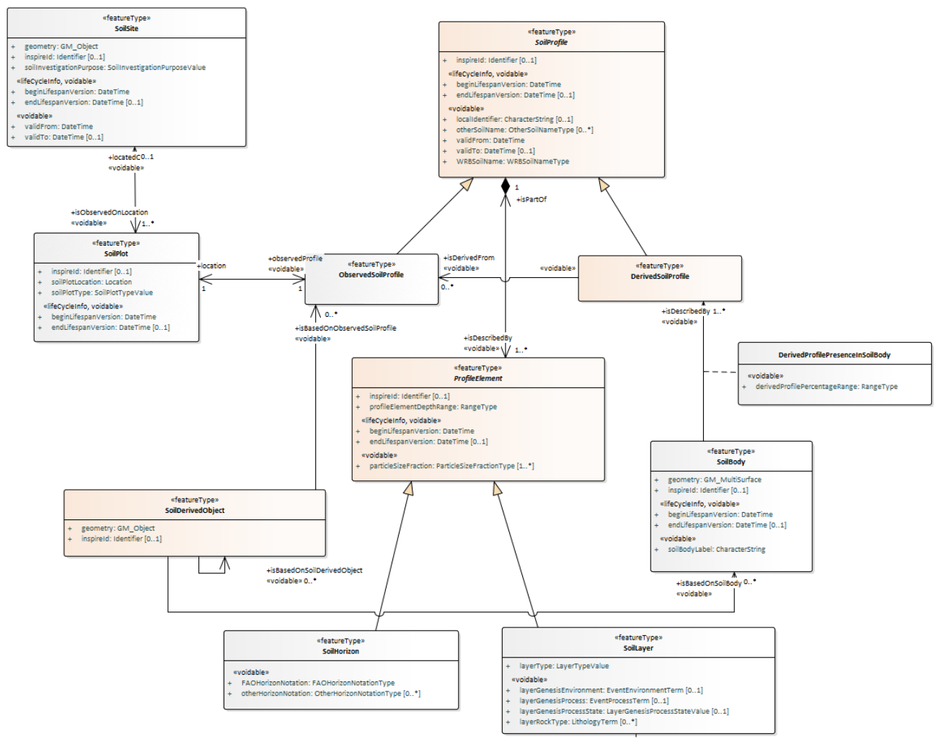
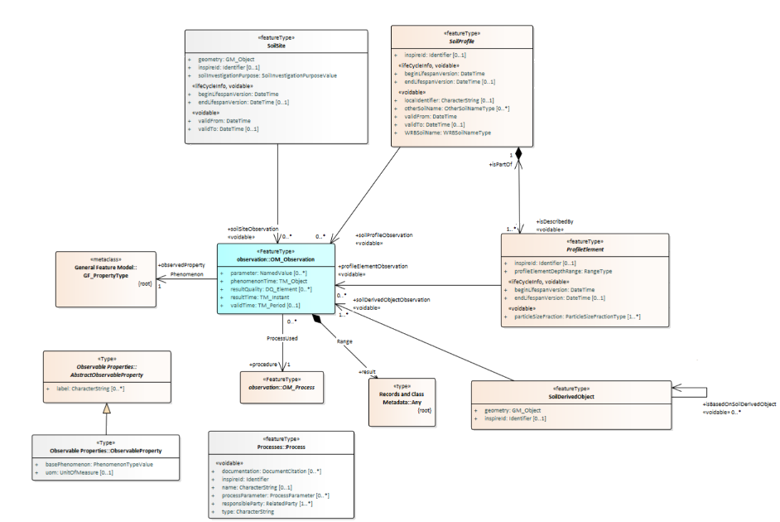
O&M for Soil
Approved INSPIRE UML model for Soil
Contained in the IR
Vector
https://inspire-mif.github.io/uml-models/approved/html/

Slide 20
INSPIRE Soil in a nutshell
Data in the scope
Soil inventories: one-off assessments of soil conditions and/or soil properties at certain locations and at a specific point in time allowing soil monitoring.
Soil maps: spatial representation of the soil types and properties. Other soil-related information derived from soil properties, possibly in combination with non-soil data, are also in the scope.
Data model
Contains a core set of spatial object types for soil data exchange
Builds on ISO 28258, ISO 19123 (for soil maps in a raster form) and ISO 19156:2011 (O&M).
Properties of soil spatial objects are modelled through associations with O&M (OM_Observation)
Primary soil classification uses the WRB and the FAO horizon notation schemes.

Slide 21
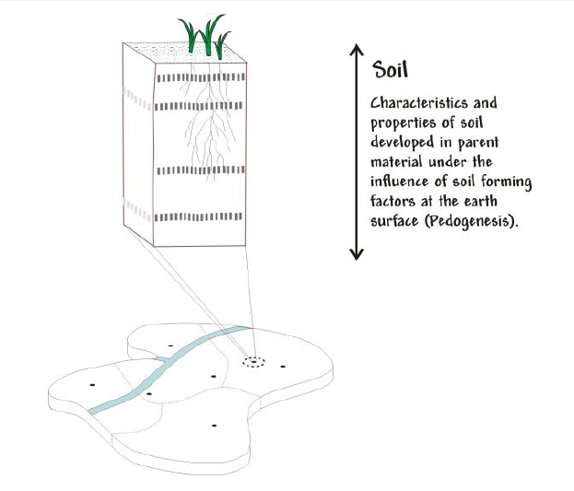
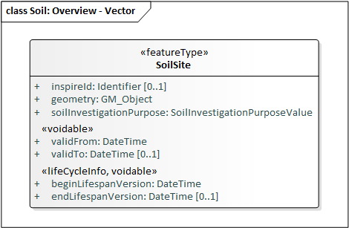
SoilSite
Area within a larger survey, study or monitored area, where a specific soil investigation is carried out
A site often represents only the loosely defined environment of the plots, and the geometry attribute can be a surface or a point.
Soil Site

Slide 22
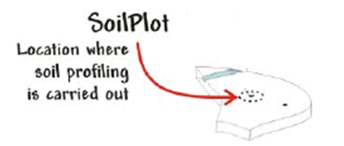
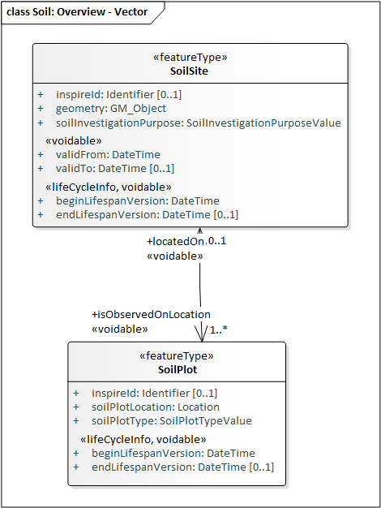
SoilPlot
It is the location where soil profiling is carried out
It is located on a SoilSite.
Its position in space can be provided either as
Spatial representation (point)
Description of the location using text or an identifier.
A soil plot is of a certain type: e.g., trial pit, borehole, sample.

Slide 23
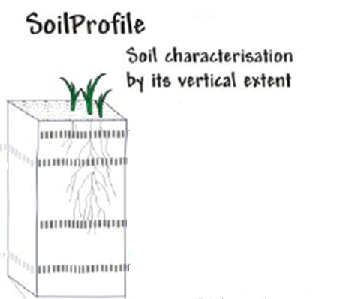
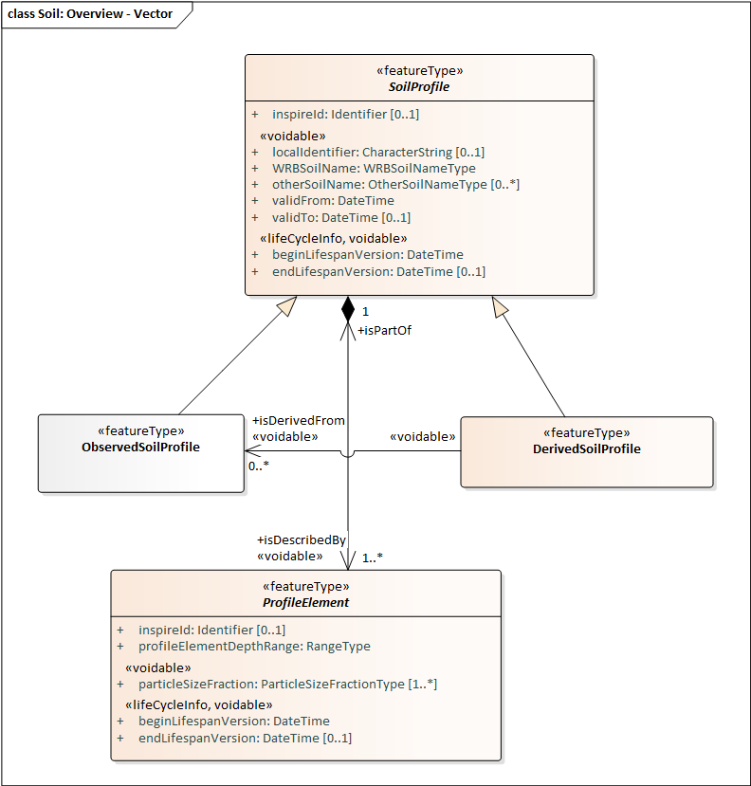
SoilProfile
Cross section of the soil from the surface down to the material unmodified by pedogenesis.
Can be observed or derived
An observed soil profile refers to a real-world location (specified by an associated soil plot).
A derived soil profile has property values derived (e.g., averaged) from the corresponding values of one or more observed profiles.
Soil profile is composed of several profile elements (horizons and layers)

Slide 24
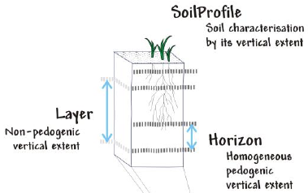
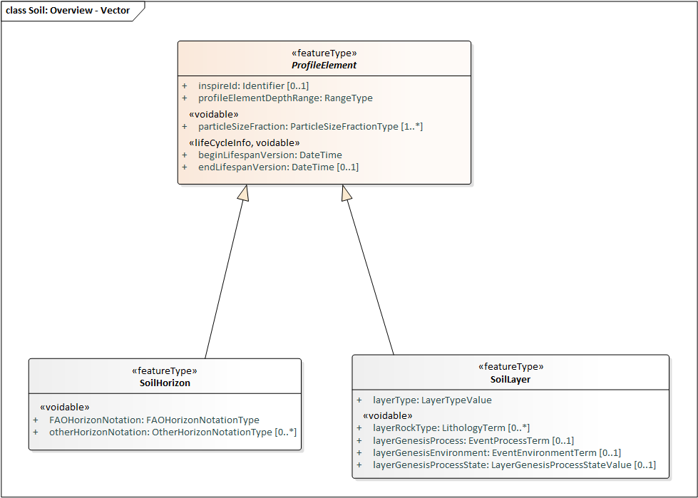
Horizons and Layers
Horizon:
A homogenous section of a profile with similar characteristics (physical /chemical /biological).
Distinguished primarily by texture, colour, structure, chemical composition, biomass.
Name according to the FAO horizon notation scheme
Layer:
Arbitrary section of a profile.
May not correspond to pedo-genetic horizons.
Often defined by fixed depth intervals
classification according to concept that fits the purpose e.g., topsoil
SoilHorizon and SoilLayer are subtypes of the abstract feature type ProfileElement

Slide 25
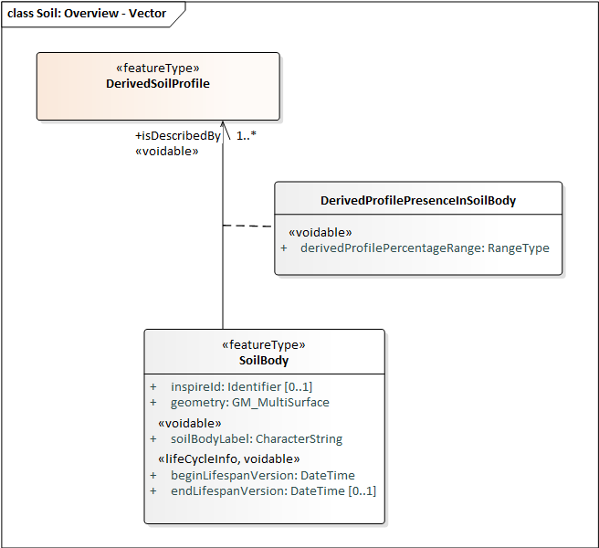
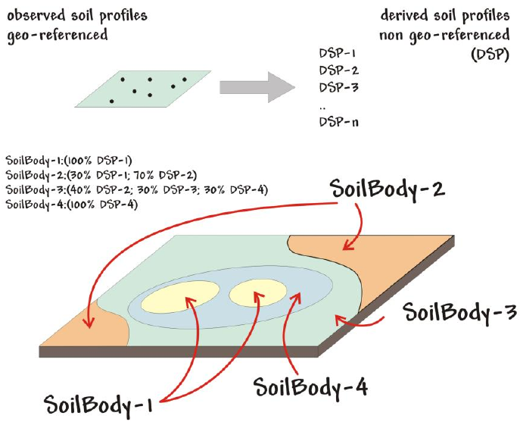
SoilBody
Association of soils found together within an area.
Equivalent to a Soil Mapping Unit (SMU).
Described by one or more derived soil profiles that are found together in the area specified by the “geometry” attribute of the SoilBody.

Slide 26
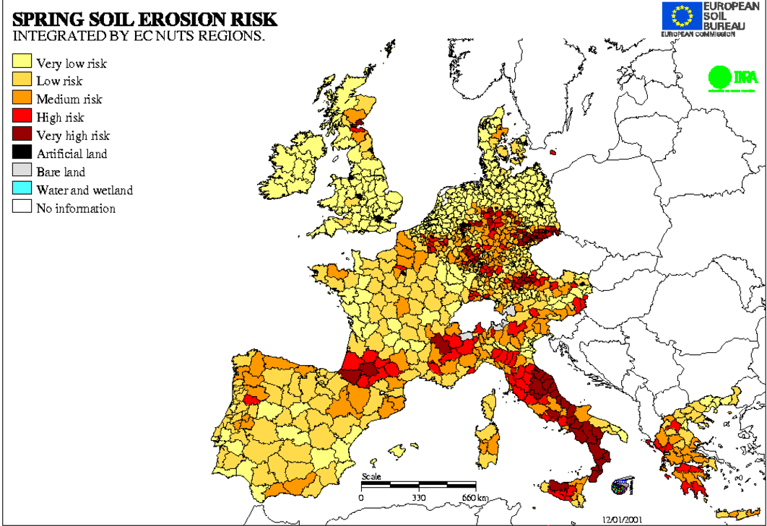
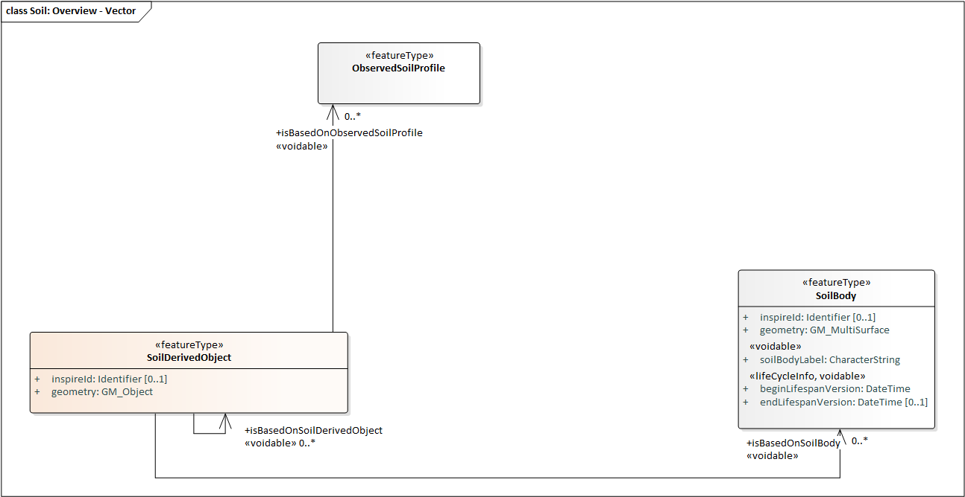
SoilDerivedObject
A spatial object representing a soil related property.
Can be associated with one or more SoilProfile or SoilBody objects
Can also be derived from other kinds of data, e.g. climate.
Example:
A map of soil erosion risk created by a predictive model.

Slide 27
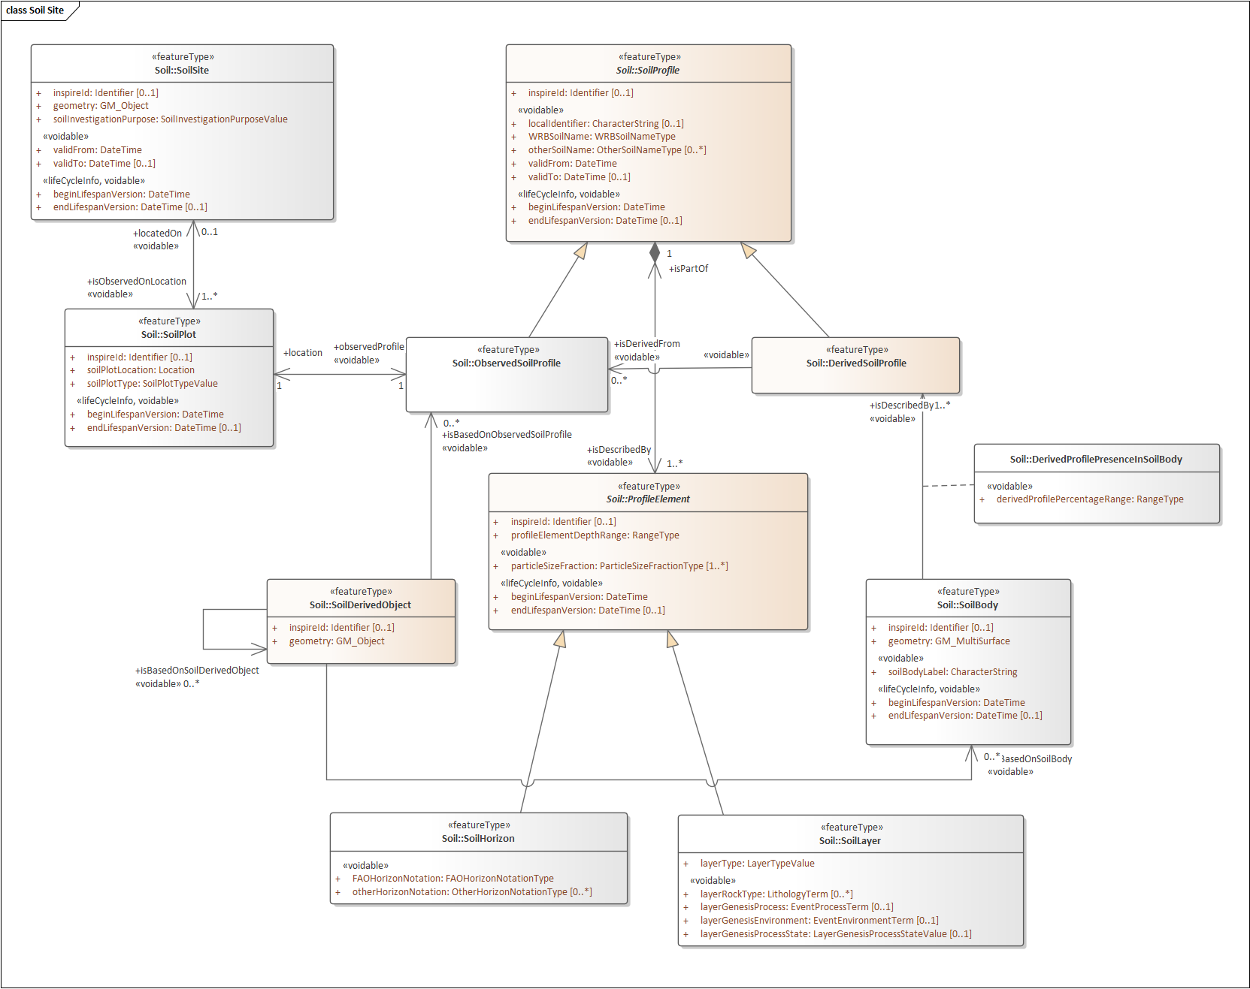
Soil Vector Overview

Slide 28
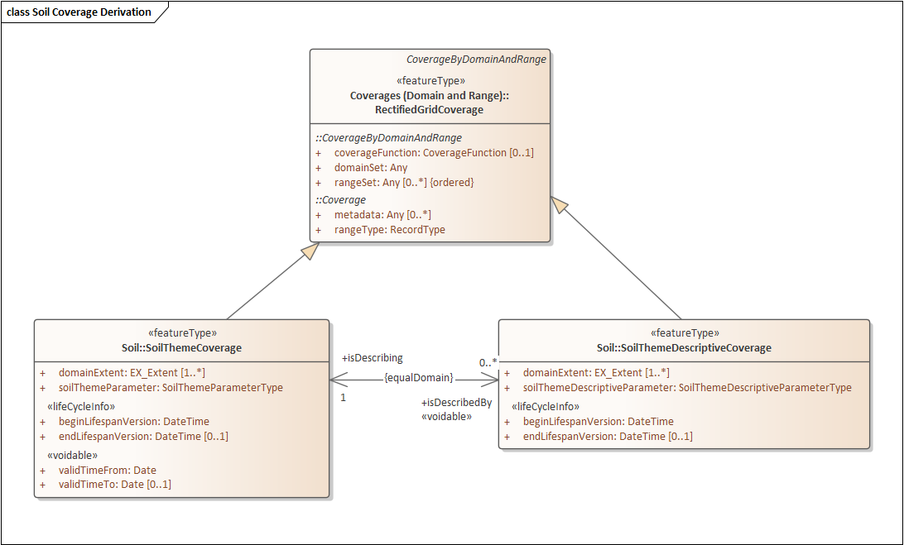
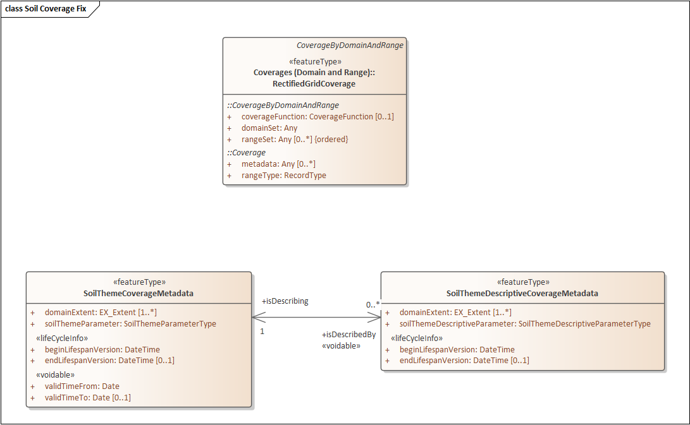
Soil Coverage Model
The ability to provide thematic soil maps in raster form is based on the ISO 19123 Coverages standard.
Conceptual Model initially provided in INSPIRE was not suitable for provision via Web Coverage Service (WCS)
The issue has been fixed via INSPIRE Good Practice “OGC compliant INSPIRE coverage data and service implementation”

Slide 29


….tea
Coffeeee…

Slide 30
Q&A TIME

Slide 31
Connecting soil properties and measurements to the Features of Interest (that is, to the components of the Soil Model structure)

Slide 32
Observation and Measurements Standard
O&M in INSPIRE Soil

Slide 33
Observations & Measurements (and Samples)
Properties of Soil spatial objects are modelled through associations with O&M observations
INSPIRE refers to ISO 19156:2011 Geographic information - Observations and measurements (O&M).
Current standard is ISO 19156:2023 Geographic information — Observations, measurements and samples (OMS)

Slide 34
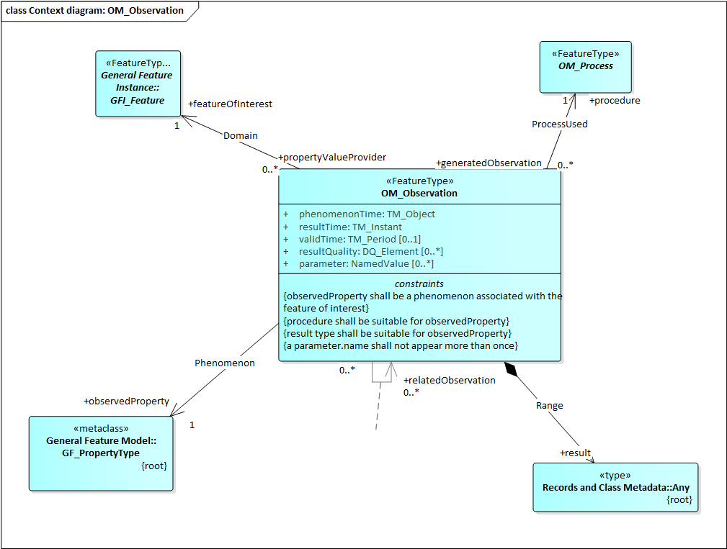
OM_Observation
Observation is closely linked to:
Feature of Interest: real-world object whose properties are under observation
Observed Property: individual property being observed on a feature of interest.
Procedure: action performed on a feature of interest to measure a property.
Unit of measure: the magnitude of a measurement made on a feature using a particular procedure.
The ‘result’ class provides the actual placeholder for measurement results. The result can be of ‘any’ type.
e.g. Soil Horizons or Layers
e.g. in saturated paste
e.g. pH in water
e.g. 7.5

Slide 35
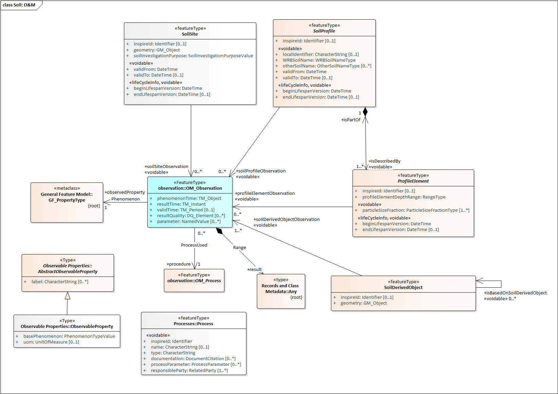
Soil O&M Overview
Feature of interest

Slide 36
Provision of sensor-based observations

Slide 37
Provision of sensor-based observations
The Sensor Observation Service (SOS) standard is used as one of the Download Services for INSPIRE data (Technical Guidance for implementing download services using the OGC Sensor Observation Service and ISO 19143 Filter Encoding)
SOS is an OGC Web Service (OWS)
based on O&M
XML Encoding
Limited Filtering capabilities
Difficult to use

Slide 38
Provision of sensor-based observations
After the endorsement of the related Good Practice, INSPIRE sensor-based observations can also be provided according to OGC SensorThings API (STA) standard:
Lightweight API
Based on O&M + Datastream
Powerful query/filter options
JSON Encoding
Easier to use
Given the nature of the soil data of interest, mostly (though not exclusively) based on sensor detections, the observations and measurements in the EJPSOIL proposal for INSPIRE Soil are based on the OGC SensorThings API (STA) model.

Slide 39
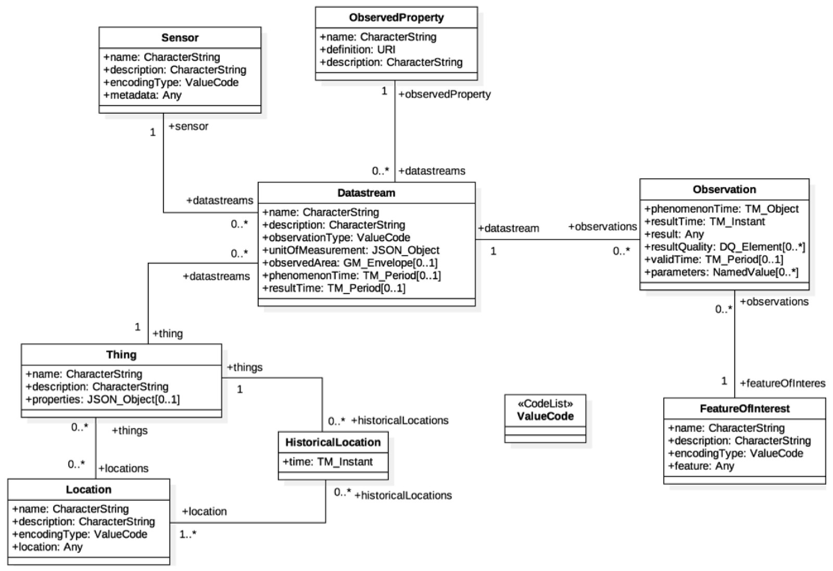
SensorThings API Data Model
(based on O&M)

Slide 40
….tea
Coffeeee…

Slide 41
Q&A TIME

Slide 42
The INSPIRE SOIL implementation in Geopackage format

Slide 43
The GeoPackage encoding standard

Slide 44

The GeoPackage Encoding Standard
Developed by OGC as an open format for geospatial information, the “GeoPackage is an open, platform-independent, portable, self-describing, compact format for transferring geospatial information”
In practice, a geopackage file is a database (SQLite3) container.
A single file can store and handle large numbers of spatial features and related attributes in a relatively small size.
It can also store tile matrix sets of imagery, raster maps, tile gridded coverage data, metadata and schema constraints.
It is particularly suitable for use in a GIS (desktop) environment.

Slide 45
Major plus of the GeoPackage encoding
GeoPackage is well supported by common desktop, mobile and Web GIS platforms, as well as by ETL tools
It is particularly efficient where connectivity and bandwidth are limited.
Since a GeoPackage file is a database container:
Data can be accessed and updated in a "native" storage format.
A single file can store multiple vector layers with different geometry type.
Vector layers are spatially indexed and common operations such as loading, updating and querying - e.g., in GIS environments, are fast.
There is in practice no limit on the file size
It’s possible to create spatial views and to filter via SQL queries.

Slide 46
The GeoPackage encoding of INSPIRE datasets

Slide 47
Good Practice on the GeoPackage encoding of INSPIRE datasets
The Good Practice on the “GeoPackage encoding of INSPIRE datasets” details how to create INSPIRE datasets in GeoPackage format
Datasets complying with the specification of this Good Practice are INSPIRE compliant
The focus of the Good Practice is on producing GeoPackage models that are optimised for use in GIS environments
The Good Practice can be used on core INSPIRE models, on extended models and on specific use cases. This means that for the same INSPIRE theme multiple models could become available over time.

Slide 48
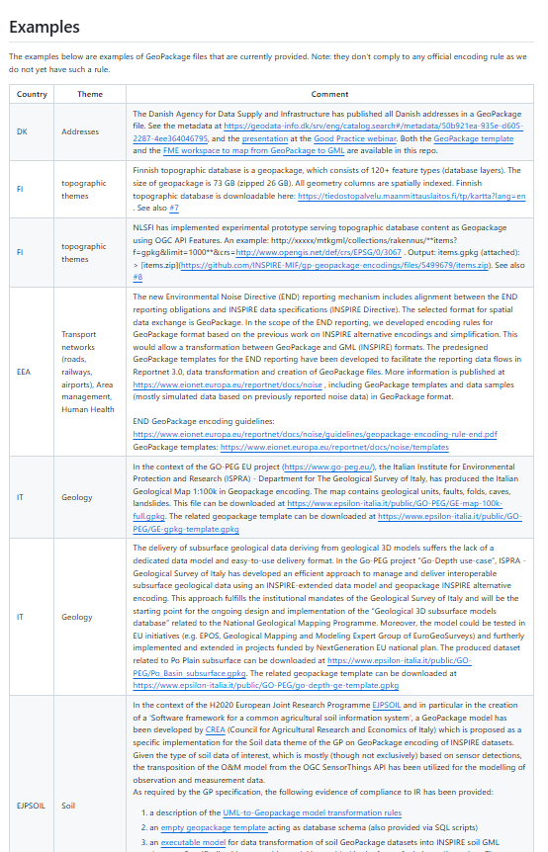
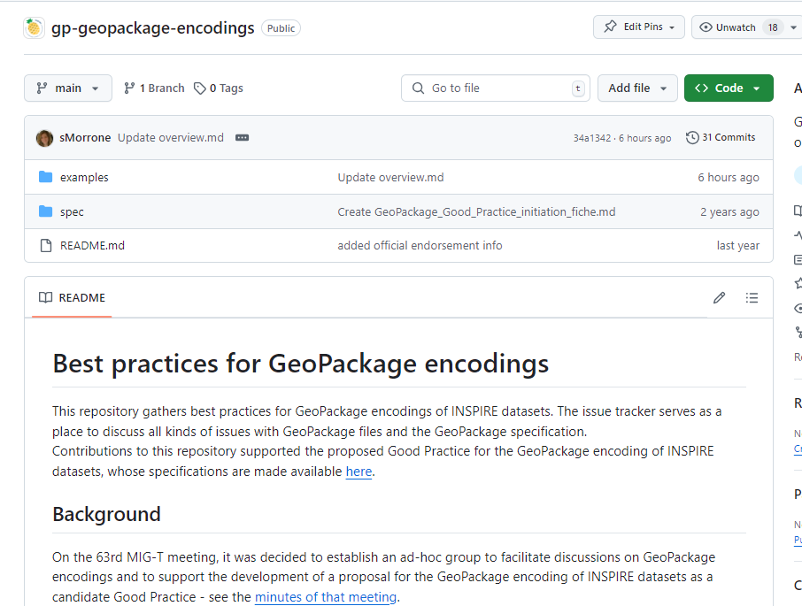
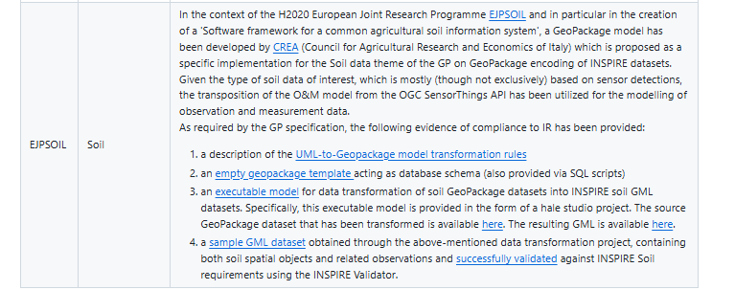
Good Practice on the GeoPackage encoding of INSPIRE datasets
Theme-specific implementations of the Good Practice must be provided by the implementers, such as the Member States and the public bodies (e.g., EEA).
Implementation examples must be documented on the INSPIRE-MIF GeoPackage repository.

Slide 49
Main benefits of the GeoPackage Good Practice
to Data Providers:
the data models may focus on key values, which simplify data harmonisation
encoding based on the use of templates reduces number of schema and encoding errors
usability and re-usability of provided data is considerably improved
GeoPackage files can handle large number of features in a smaller file size, facilitating the sharing and management of entire data sets, sized medium to large.
to Data Users:
the simplified data model aligns directly with use cases
GeoPackage encoded data can be directly used in GIS tools, with good performance.
data consumption is considerably improved with possibility to directly edit/update data, create views and store styles
loading data on GIS or making queries on the file database is faster, since the vector layers are inherently rtree indexed (spatial indexing).

Slide 50
Theme-specific implementations: how it works
Theme-specific implementations of the Good Practice must provide:
A description of the logical model
An empty GeoPackage template
UML-to-Geopackage model transformation rules, conforming to the generic (encoding-agnostic) INSPIRE model transformation rules and to the geopackage-specific transformation rules.
An executable model for data transformation of GeoPackage data to GML default encoding. This can be an ETL workbench (e.g., hale studio project, FME workbench), a standalone program or a service. In all cases, the executable model must be also documented in a human-readable form.

Slide 51

Theme-specific implementations: Validation
Technical compliance with INSPIRE shall be demonstrated by:
data transformation to the default encoding (GML)
successful validation of the resulting dataset (or subset of) using the INSPIRE Validator
Once-only validation:
data providers using the GeoPackage templates to report data could avoid the conformity proofing process and refer to the relevant theme-specific implementation example validation, provided that they use the same geopackage structure (geopackage template) and that quality checks on the geopackage content (e.g., triggers) are in place.

Slide 52

Geopackage model for the INSPIRE Soil
EJPSOIL soil proposal
https://github.com/ejpsoil/inspire_soil_gpkg_template

Slide 53
EJPSOIL Good Practice for the provision of INSPIRE Soil data in GeoPackage format
It’s a theme-specific implementation of the Good Practice on the GeoPackage encoding of INSPIRE datasets (for the Soil data theme)
Meets the needs for an efficient exchange of soil data & can be used to deliver INSPIRE compliant soil data
Compliance with INSPIRE has been demonstrated in accordance with the provisions of the Good Practice

Slide 54
Transformation of the INSPIRE Soil conceptual model into GeoPackage schema
To transform the Soil UML into corresponding GeoPackage schema, the following types of transformation rules have been applied:
generic (encoding agnostic) INSPIRE model transformation rules,
encoding-specific INSPIRE UML-to-GeoPackage encoding rule,
transformation rules developed specifically for the soil data theme and in the scope of the EJP SOIL GeoPackage work.

Slide 55
Transformation rules examples
Flattening of hierarchical structures and complex data types:
For multiplicities 0 or 1 the applied rule consisted in moving the child elements to the parent (Flattening of Nested Structures (MT001) .
For multiplicities greater than 1 (not addressed by abovementioned INSPIRE flattening rules), tables for the data types have been created.

Slide 56
Transformation rules examples
GeoPackage Properties rule
If a property of a feature type has a maximum cardinality of 1, it is mapped to a column in the related table. The column name is the same as the property.
If a property has a cardinality greater than 1, a suitable mapping needs to be found on a case-by-case basis.
If a property represents values from code lists and enumerations the type of the column is TEXT, and the values from the code lists and enumerations are encoded using the literal of the value.

Slide 57
Transformation rules examples
Associations with 1:n multiplicity
A related attribute is introduced in the destination table which is the foreign key to the source table.
Associations with n:m multiplicity
Many-to-many relationships have been represented using a relationship table. A relationship table is composed of a primary key and two foreign keys (one per associated table).

Slide 58
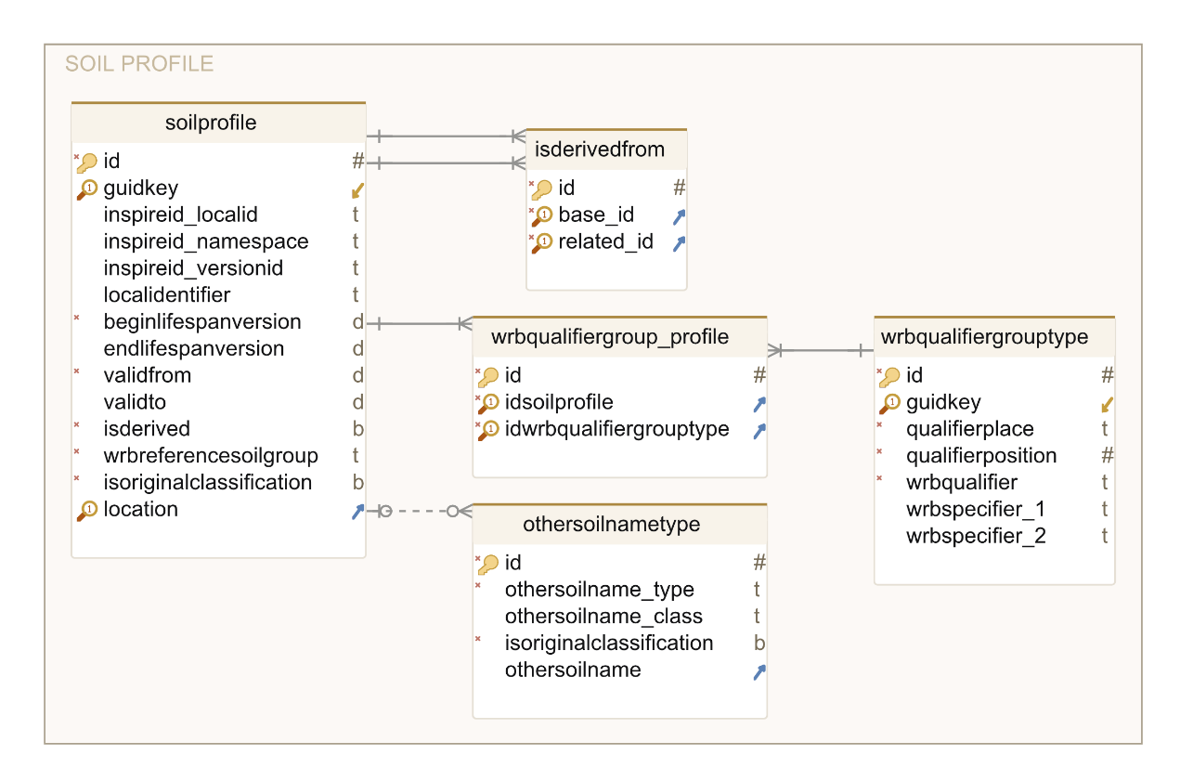

Soil-specific transformation rules examples
SoilProfile
The ObservedSoilProfile and DerivedSoilProfile, specialization with no attributes of the SoilProfile feature type, have no corresponding tables in the GPKG model. To distinguish between an observed and a derived profile the “isderived” BOOLEAN attribute has been added to the soilprofile table. The attribute is set to TRUE when the profile is derived. In addition, a specific trigger checks that derived soil profiles have null values for the location attribute (association to soilplot).

Slide 59
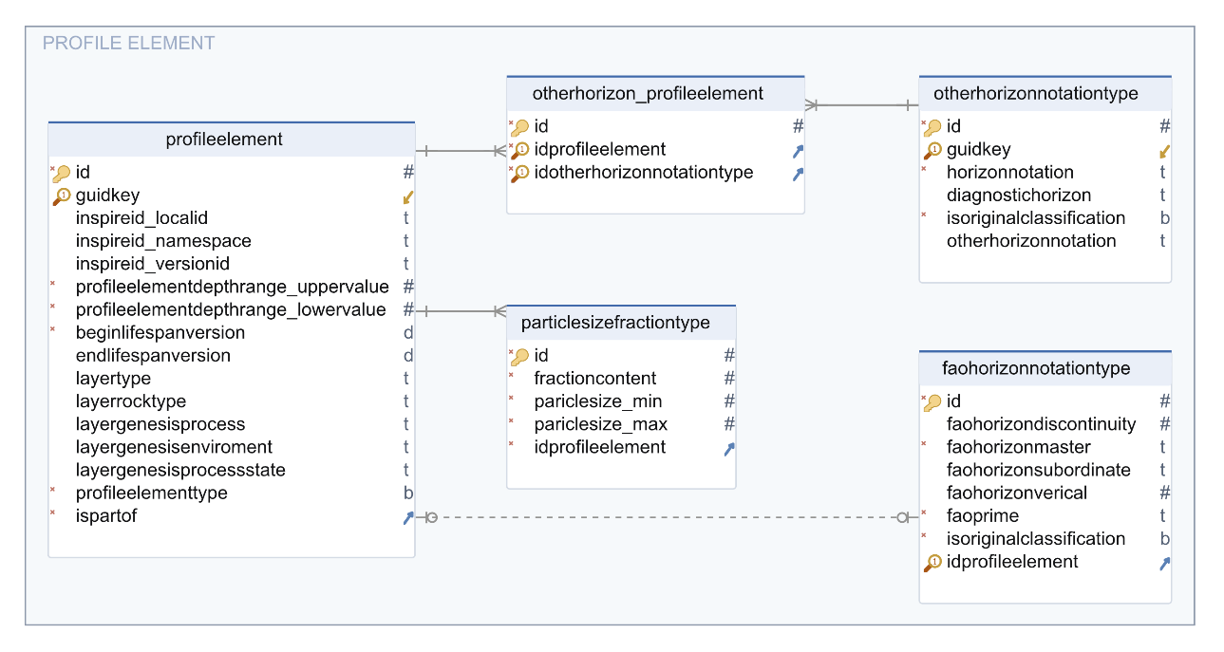
Soil-specific transformation rules examples
ProfileElement
The SoilHorizon and SoilLayer have no corresponding tables in the model.
All the SoilLayer attributes have been incorporated in the ProfileElement table. Conversely, the Horizon attributes (FAOHorizonNotation, complex data type with multiplicity 1, and otherHorizonNotation complex data type with multiplicity 0..n) are represented as tables linked to the ProfileElement by related foreign keys.

Slide 60
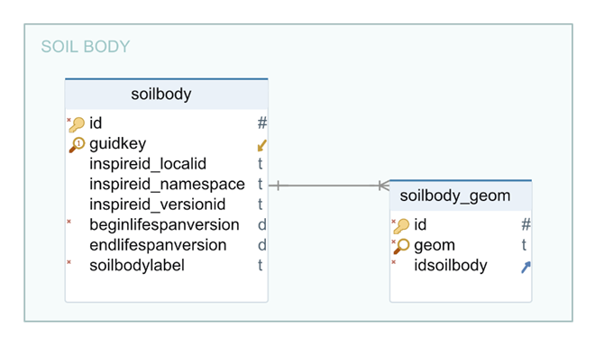
Soil-specific transformation rules examples
SoilBody geometry
The same soil body may refer to different geometries' representations (soil maps at different scales and level of details). For this reason, the geometry of a soil body is handled in a dedicated table linked to the related soil body via a foreign key.

Slide 61
Use of SensorThingsAPI to model observations and measurements
SensorThings API provide a standard way to manage and retrieve observations and metadata from sensor systems:
Given the type of soil data of interest, mostly (though not exclusively) based on sensor detections, the transposition of the O&M model from the OGC SensorThings API has been utilized for the modelling of observation and measurement.
Using the SensorThings API does not affect compliance to INSPIRE as the related model contains all the necessary O&M information.

Slide 62
Specific transformation rule for SensorThingsAPI
Datastream and DatastreamCollection
A measuring instrument (“Thing”) may have multiple sensors sharing the same observed area, phenomenon and result time, but each with own observed property, process and datastream.
The output of the measuring instrument is a single file with datastreams of all the sensors.
To model the measuring instrument output (i.e., the single file with measurements from all the sensors) the EJPSOIL proposal adds to the model the concept of datastream collection (DatastreamCollection).

Slide 63
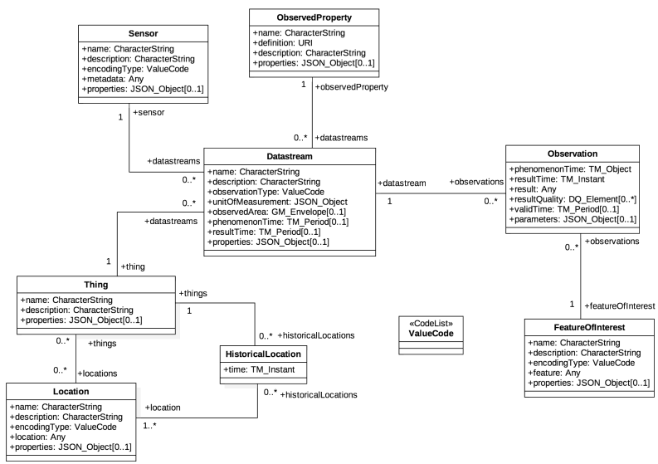
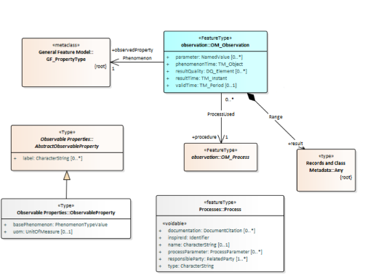
O&M for Soil
SensorThings
FOI
Phenomenon
Process
WHAT’s observed
WICH property
WHAT’s
the result
HOW to describe
WICH property
Datastream
Observation Result
Phenomenon
Observation
WHAT’s
the result
HOW to describe
WHAT’s observed
Thing
Process
FOI
Result
Notes:
The Datastream collects all the relations among the Observation Result and the Process, Phenomenon, Thing

Slide 64
O&M for Soil
/
SensorThings
Thing
Datastream
Phenomenon
Phenomenon
Process
FOI
Process
FOI
Observation Result
Observation
Result

Slide 65
O&M for Soil
/
SensorThings
Thing
Datastream
(Many)
(file Information)
Phenomenon
Phenomenon
Process
FOI
Datastream (Single)
(result relations)
Process
FOI
Observation Result

Slide 66
O&M for Soil
/
SensorThings
Thing
Datastream Collection
Phenomenon
Phenomenon
Process
Feature Key
Phenomenon Key
Process Key
Datast. Collect. Key
Observation Key
Process
Feature of Interest
Feature Key
Phenomenon Key
Process Key
Datast. Collect. Key
Observation Key
FOI
Observation
Observation Result
Any

Slide 67
O&M for Soil
/
SensorThings
Thing
Datastream Collection
Datastream
Phenomenon
Phenomenon
Process
Feature Key
Phenomenon Key
Process Key
Datast. Collect. Key
Observation Key
Process
Feature of Interest
Key Feature
Key Phenomenon
Key Process
Datast. Collect. Key
Key Observation
FOI
Observation
Observation Result
Any

Slide 68
INSPIRE validation of dataset encoded according to EJPSOIL GeoPackage

Slide 69
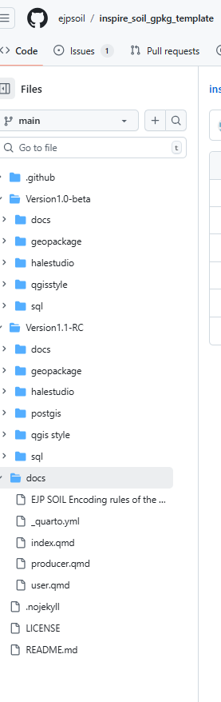
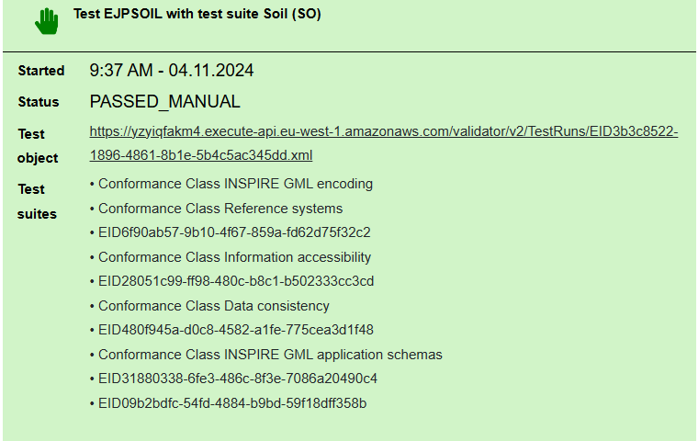
INSPIRE validation of EJP SOIL GeoPackage datasets
Evidence of INSPIRE compliance has been provided in accordance with the requirements of the Good Practice on GeoPackage encodings.
All the needed artefacts are provided in the ejpsoil GitHub repository:
a description of the UML-to-Geopackage model transformation rules,
empty geopackage template (also provided via SQL scripts),
executable model for data transformation of GeoPackage datasets into INSPIRE GML datasets.
GeoPackage source dataset fully transformed into GML and successfully validated with the INSPIRE Validator.

Slide 70
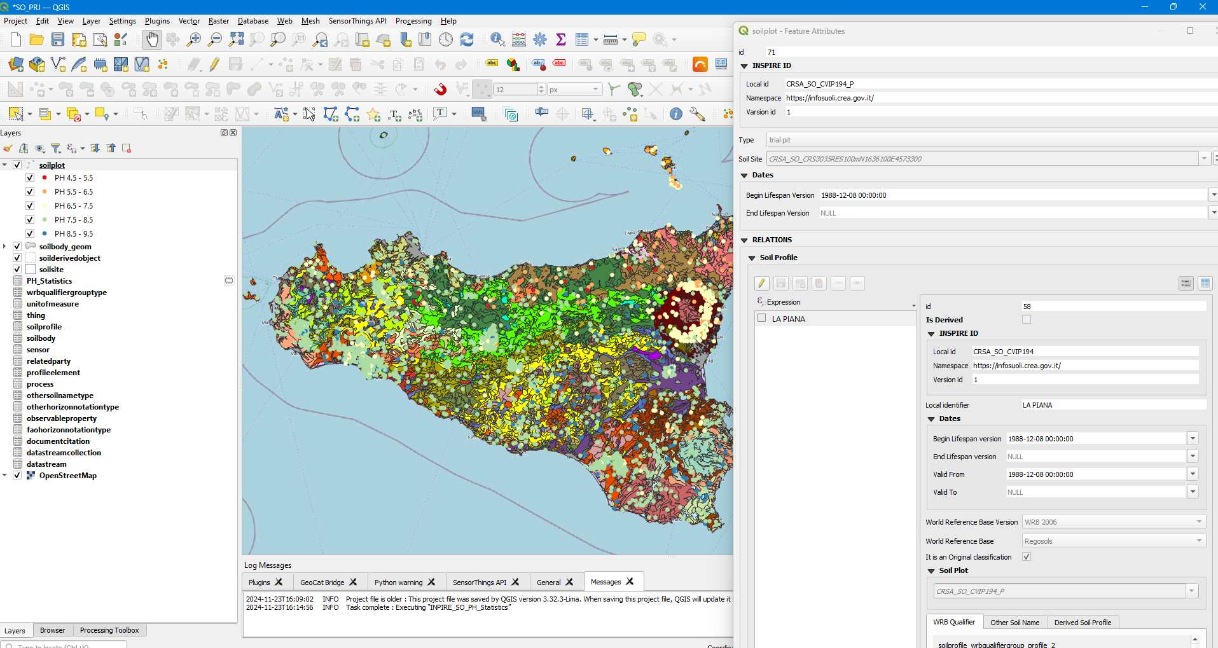
A sneak peek at the next workshop: GeoPackage INSPIRE Soil in QGIS

Slide 71
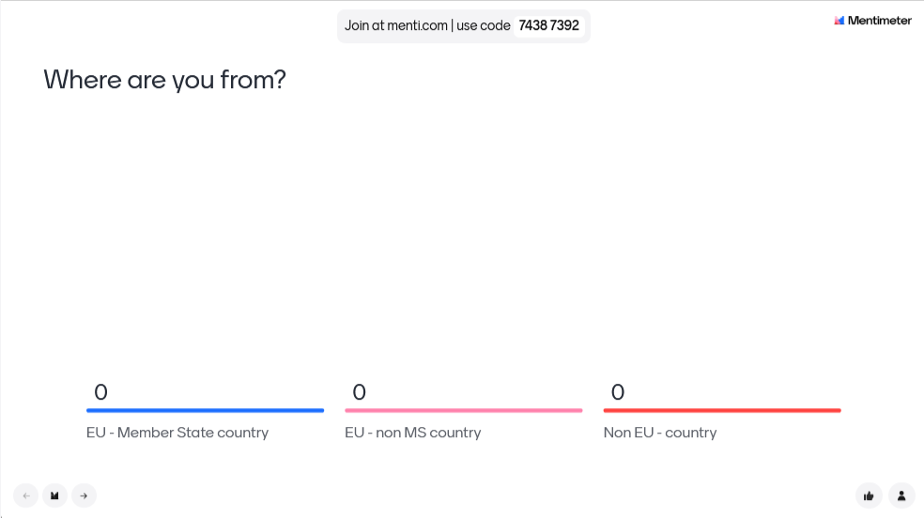

https://www.menti.com/alifxchhvhd7

Slide 72
Q&A TIME
Thanks for your attention!
We hope to see you on the Second Workshop
2nd December 2024, 11.00 to 13.00 am, CET time zone.
Recordings will be available on EJPSOIL YouTube channel https://www.youtube.com/@ejpsoil6391
The presentation will be shared on the EJP SOIL website https://ejpsoil.eu/soil-research/soil-data-monitoring-mapping-and-modelling
For questions: andrea.lachi@crea.gov.it, s.morrone@epsilon-italia.it maria.fantappie@crea.gov.it, giovanni.labate@crea.gov.it

